Slide 3
Procjena kvalitete u znanosti - što “mjeriti”, kako i zašto?
Znansteno istraživački rad složen je proces koji predstavlja sam vrh ljudske intelektualne djelatnosti. Publikacije koje iz njega proistječu za cilj imaju (ili bi trebale imati) širenje znanja i opći napredak društva. Kako je onda moguće da se tako složeni procesi često procjenjuju jednostavnim kvantitativnim metodama?
Posljednjih desetljeća sustav znanstvene komunikacije napredovao je u tehnološkom i konceptualnom smislu. Otvoreni pristup, repozitoriji, preprint servisi, novi oblici publikacija, akademske društvene mreže samo su neke od novina. Gdje je (za)ostao sustav procjene kvalitete u znanosti i kako ga možemo unaprijediti? Pridružite nam se i upoznajte se s naprednim idejama. Potaknimo raspravu o njihovoj primjeni u praksi!

Slide 4
Procjena kvalitete u znanosti - što “mjeriti”, kako i zašto?
Kakva bi procjena trebala biti?
Kakvo je stanje u Hrvatskoj?
Primjer iz Danske - Charlotte Wien, SDU, DK– Developing and following viable research strategies locally , PUBMET 2021 (12 min)
DORA
The Leiden Manifesto for Research Metrics from Diana Hicks on Vimeo (4 min).
Glasgow: How to talk about your research outputs (4 min)
Ghent: Framework for Good Research Practice (2 min)

Slide 5
DORA - The Declaration on Research Assessment San Francisco, 2012 (Annual Meeting of the American Society for Cell Biology)
2021: a worldwide initiative covering all scholarly disciplines and all key stakeholders including funders, publishers, professional societies, institutions, and researchers.
VISION: to advance practical and robust approaches to research assessment globally and across all scholarly disciplines.
OBJECTIVES:
Raise awareness To call attention to new tools and processes in research assessment and the responsible use of metrics that align with core academic values and promote consistency and transparency in decision-making
Facilitate implementation To aid development of new policies and practices for hiring, promotion, and funding decisions
Catalyze change To spread research assessment reform broadly by working across scholarly disciplines and globally
Improve equity To call for broader representation of researchers in the design of research assessment practices that directly address the structural inequalities in academia
APPROACHES
Community engagement We publish blogs, organize community interviews, and give presentations on research assessment.
Resource development We curate collections of good practices, create slide presentations to help individuals initiate local conversations about change, and publish commentaries to provide additional guidance for stakeholders.
Partnership We work with other organizations that share our desire to reform research assessment.
Advising We advise academic institutions and funders seeking to review and revise their research assessment policies and practices.
Convening We gather diverse stakeholders at conference sessions, workshops, and meetings to work towards systems change.

Slide 6
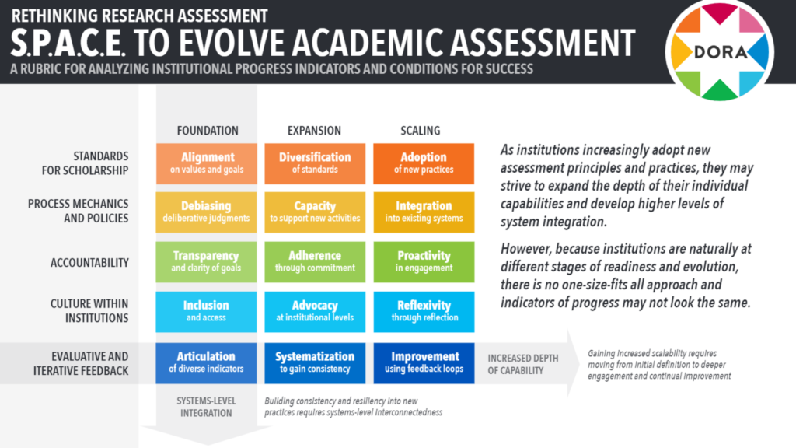
TARA - Tools to Advance Research Assessment - project to facilitate the development of new policies and practices for academic career assessment.

Slide 7
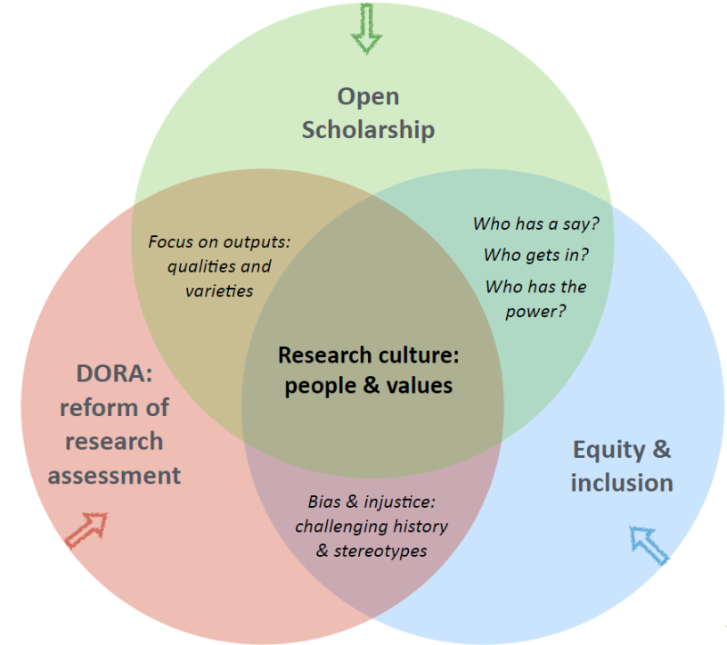
Što se želi postići?
Preuzeto s: Responsible research assessment: rethinking what we value in research – Leeds University Library Blog

Slide 8
Preporučena „literatura”
Johan Rooryck: Plan S, cOAlition S and Responsible Research Assessment
Stephen Curry: Responsible research assessment: rethinking what we value in research
Vrednotenje raziskovalnega dela z vidika odprte znanosti – René von Schomberg: The rationele of open science
Nele Bracke: Ghent University’s policy on research and researchers’ career assessment
Virginia Tech University library research guides: Tell Your Story - Impact & Engagement: Responsible Research Assessment
DORA Resource Library …

Slide 9
Hvala na sudjelovanju!
Pridružite nam se i sutra:

